Slide 1

Thematic project
Nelly Egharevba: 21347004
Muhammad Ahmad: 21313779
Hensley Brooks: 20046797
Mohammed Ahmad: 21358535
Husam Afzal: 20038399

Slide 2

Topic: code review toolkit
Tutorial
GitHub URL: https://github.com/02Nelly03/Code-review-toolkit.

Slide 3

What is a code review toolkit?
To study, appraise, and judge the code written by other developers, software engineers use a code review toolkit, which is a collection of tools, methods, and standards. It is an important step in the software development process because it guarantees that the code is of good quality, meets standards, and is easily maintainable. Tools that are frequently included in the code review toolbox include
code review software,
static code analysis tools,
testing frameworks.
It also includes code review techniques such as formal code inspections and peer reviews. Writing and reviewing guidelines, such as coding standards, style manuals, and best practises, may also be included in the toolbox.

Slide 4
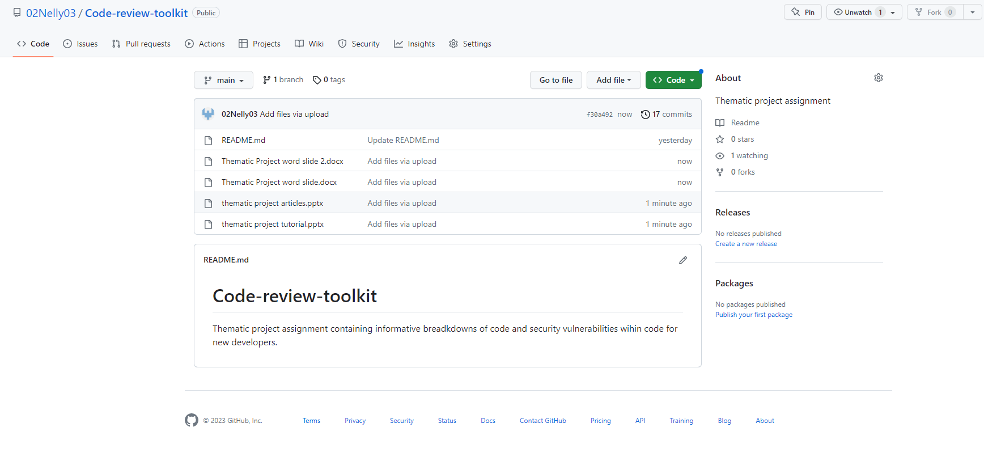
GitHub URL: https://github.com/02Nelly03/Code-review-toolkit

Slide 5

Common security vulnerabilities found in code
Cross-Site Scripting (XSS).
Broken Authentication and Session Management.
Security Misconfiguration.
Inadequate Logging and Monitoring.
Insecure communications.
injection attack occurs.

Slide 6

Cross-Site Scripting (XSS)
Is a security weakness that allows an attacker to inject malicious code into a website that is visible to other users. An attack happens when a website fails to properly check user input or output data given by users. Attackers can then inject code into a website using a variety of channels, including a comment form, a search box, or even a URL. Once the malicious code has been introduced, unwary website visitors can execute it. This can lead to a wide range of attacks, such as stealing user data or credentials, taking control of user accounts, or infecting users' workstations with malware.

Slide 7
Broken Authentication and Session Management
A security vulnerability in which an attacker gains unauthorised access to user accounts, sensitive data, or other resources by exploiting gaps in an application's authentication and session management mechanisms is known as broken authentication.
A broken authentication vulnerability can develop due to a number of factors, including:
Weak or predictable passwords that are easy to guess or crack.
Password rules that are insufficient, such as asking users to change their passwords on a regular basis or defining minimum password length and complexity criteria.
Inadequate multi-factor authentication (MFA) or other robust authentication measures implementation.
Insecure session management, such as failing to properly expire user sessions or using secure cookies.
Inadequate access controls, such as allowing users to bypass login or permission checks by modifying URLs.

Slide 8
Security Misconfiguration
Security misconfiguration is a security vulnerability that occurs when a software programme or system is not properly configured to protect against potential attackers.
Misconfigured security can occur for a number of reasons, including:
Inability to timely install security updates or fixes.
Using easily guessable or hacked weak or default passwords.
Using unsecure or default web server, database, or other component settings.
Failure to properly configure access controls such as file permissions, user roles, or network segmentation.
Inadequate logging and monitoring make it difficult to detect and respond to security vulnerabilities in a timely manner.

Slide 9
Inadequate Logging and Monitoring
Inadequate logging and monitoring is a type of security vulnerability that occurs when an application or system fails to log and monitor security events and actions appropriately. This makes detecting and responding to security events in a timely manner difficult or impossible. Inadequate logging and monitoring can expose systems and applications to attacks including data breaches, insider threats, and unauthorised access. The process of recording occurrences or activities in a software or system, such as login attempts, database queries, or file accesses, is known as logging. Monitoring means regularly reviewing these logs for any suspicious or unexpected activities. Inadequate logging and monitoring can arise due to a number of factors, including:
Inadequate documentation of all critical security occurrences and actions.
Inadequate or inconsistent logging makes it difficult to recreate security incidents.
The absence of real-time monitoring makes recognising and responding to security incidents more difficult.

Slide 10
Insecure communications
The use of communication channels or protocols that do not effectively protect the confidentiality, integrity, or authenticity of the information being conveyed is referred to as insecure communications. Insecure communications can expose critical information to attackers through interception, eavesdropping, tampering, or impersonation.
Insecure communications include the following:
Sending unencrypted emails: Unencrypted emails can be intercepted and read by attackers, exposing important information.
Using unprotected Wi-Fi networks: unprotected public Wi-Fi networks allow attackers to intercept and read data being transmitted across the network.
Using unencrypted messaging apps: Messages that are not encrypted end-to-end can be intercepted and read by attackers.

Slide 11
Injection attack occurs
What are injection attacks?
Injection attacks are a type of security vulnerability in which a malicious code or data is injected into an application to cause it to behave abnormally or get access to sensitive information. These assaults are frequently linked to online programmes that connect to a backend database or other data storage systems. Injection attacks can be classified into numerous categories, including:
SQL injection: An attacker uses this form of attack to insert malicious SQL code into an application's input fields in order to execute unauthorised database commands or retrieve sensitive data.
Cross-site scripting (XSS): An attacker injects malicious code into a website, which then executes when a user visits the site, allowing the attacker to steal sensitive data or take control of the user's account.

